Slide 1
Flood Detection using the synergic of Optical and SAR imagery
Motivation
It is not possible to capture images of a region in harsh climatic conditions using optical images when the SAR technology could be a used to obtain clear images.
Better detections could help take the right precautions to fight floods.
Detection of flooded areas can help rescue flood-struct people.

Slide 2
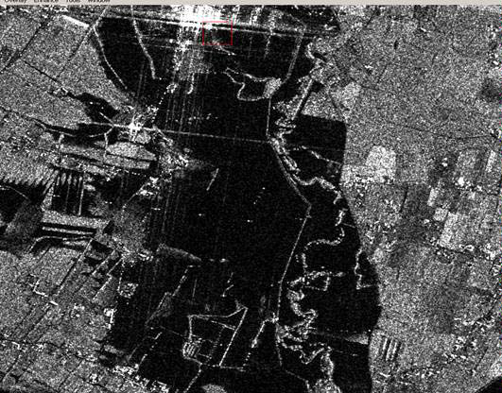
Why synergic use of SAR and optical images?
Optical satellites
Very high resolution(VHR) (<1m)
Are affected by cloud coverage.
Acquired only during day time.
Can’t detect forested areas due to passive sensor limitations.
SAR satellites
Not affected by cloud coverage.
Acquired during day and night time.
Can also achieve a very high resolution.
Very effective when the standing water creates a flat surface.
Can’t detect in urban and vegetated areas due to resolution and active sensor limitations.
Fused data implements the advantages of both of them and removes the limitations of either one of them!
SAR image

Slide 3

Proposed Methodology
Decision Tree Algorithm using parameters
SAR parameters
VV polarization.
Optical parameters
Bands B1 - B12
Custom parameters
RSWIR (Red Short Wave Infrared)
RSWIR = (Red - SWIR) / (Red + SWIR)
SWIR = avg(B9, B10, B11)
SWIR range: 900 - 1700 nm
NDVI (Normalised Difference Vegetation Index)
NDVI = (NIR - Red) / (NIR + Red)
NIR = near infrared band (760 - 850 nm)

Slide 4
Why Decision Tree?
Decision tree: It makes all possible alternatives and traces each alternative to its conclusion in a single view, allowing for easy comparison among the various alternatives.
Nonlinear relationships between parameters do not affect tree performance RSWIR: The comparative analysis of RSWIR with NDWI and GSWIR using spatial statistical techniques and visual interpretation suggests RSWIR to be more efficient for delineating water bodies during floods.

Slide 5
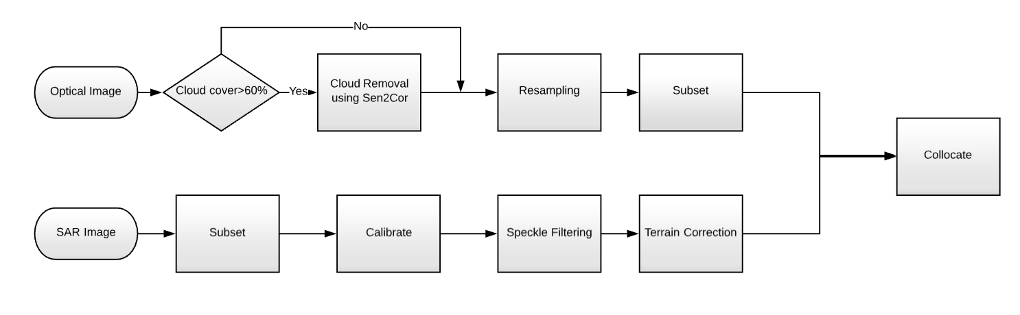
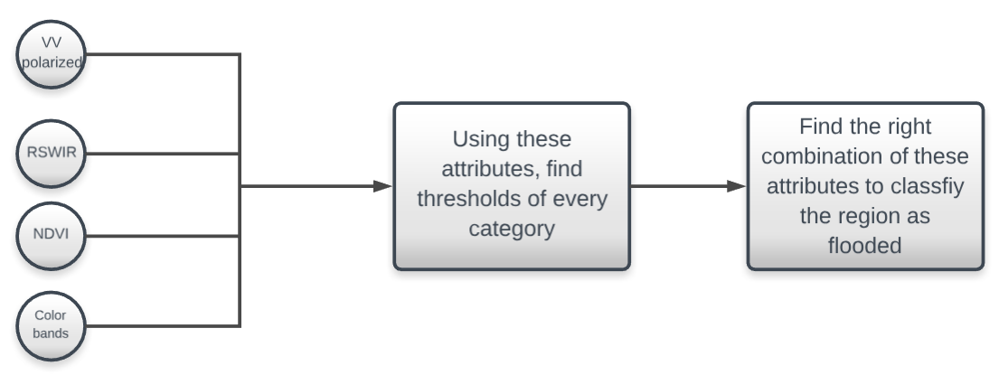
FLOWCHART
Preprocessing
Training

Slide 6
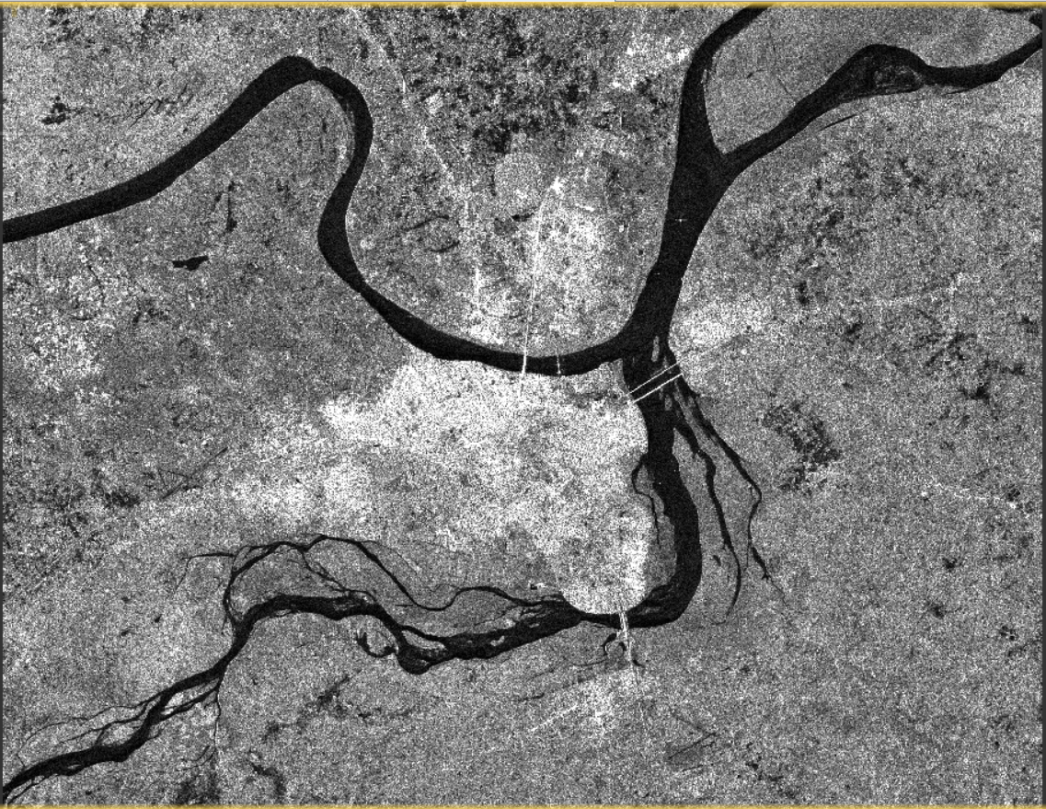
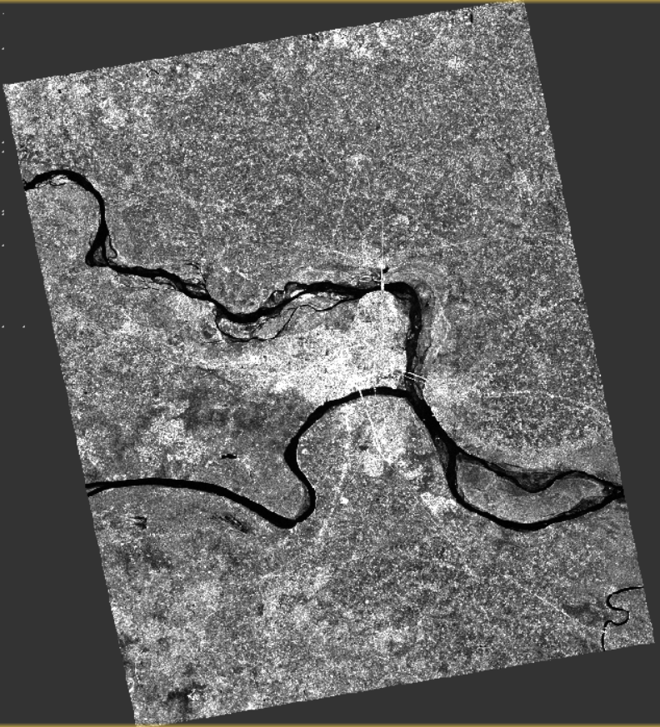
After Terrain Correction
After subset

Slide 7
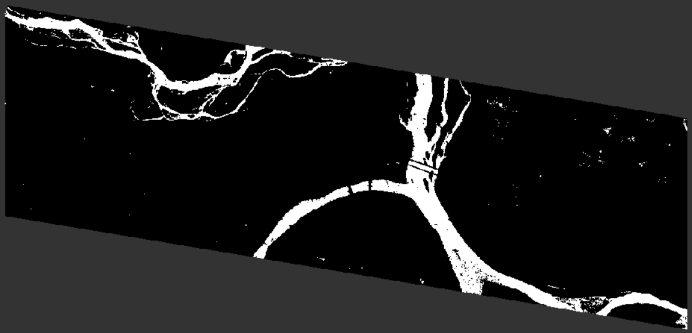
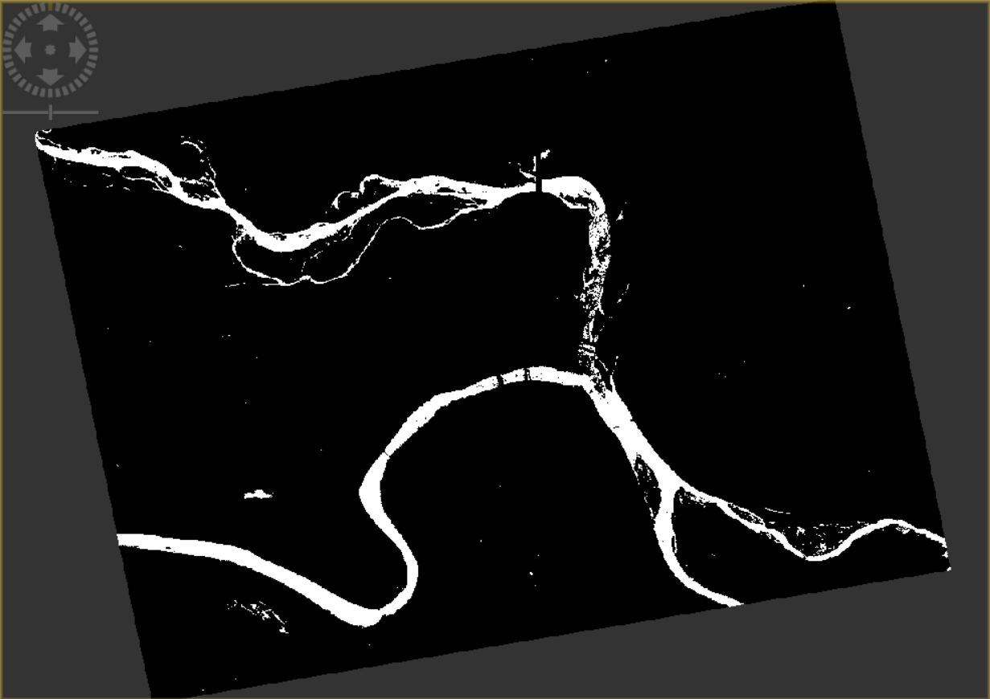
August
September

Slide 8
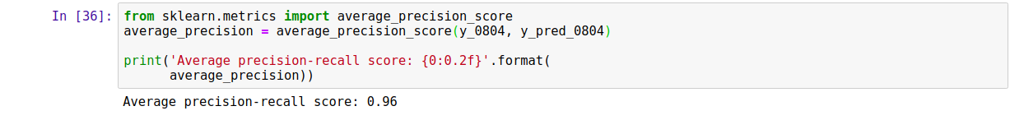
Accuracy = 99.65%
Confusion matrix
Average precision-recall score= 0.96

Slide 9
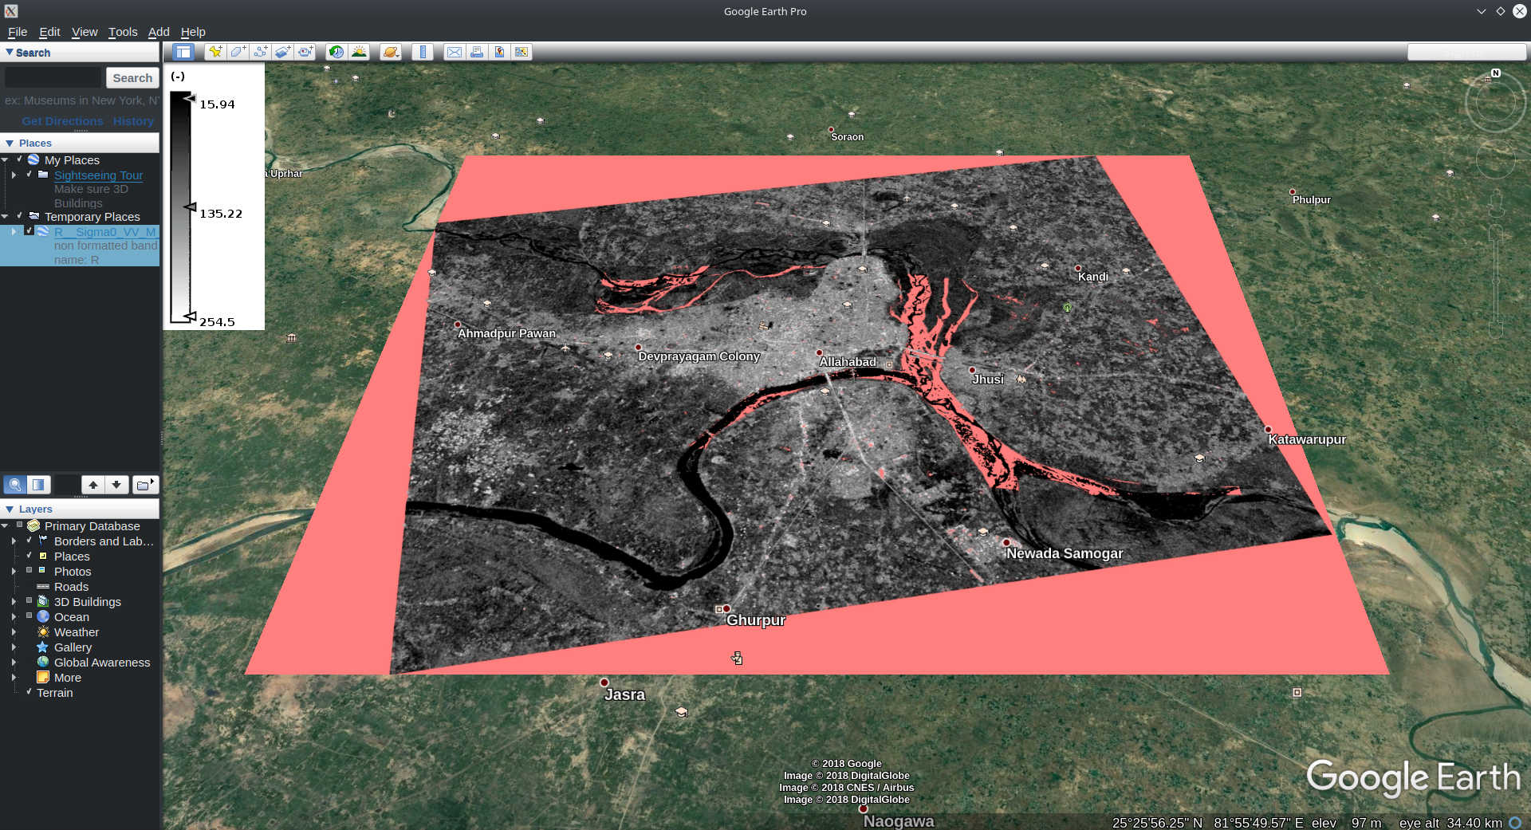
Flooded region AUGUST

Slide 10
Software requirements and plans
The raw data for SAR and optical images of Sentinel 1, Ground Range Detected (GRD), and different polarizations is obtained from https://scihub.copernicus.eu
Processing of the images including calibration, noise and speckle reduction, cloud removal, pixel-based mathematical operations and masking is done by Sentinel Application Platform (SNAP).
Data conversion and Band Maths creation of different attributes was done using Exelis Envi.
Training and testing of the flooded image is done on jupyter notebook using python.
Flood prediction
PLANS
Make a GUI based alert system.
Open to other innovative ideas!
Presented by:-
IEC2016012 Nikhil Mundra
IEC2016026 Agam Dwivedi
IEC2016072 Ruchin Agrawal

